Slide 1
Rcc institute of information technology
Paper Name: Software Engineering using UML
Paper Code: MCAN-301
Topic: Waterfall Model
Name: Tiasha Hait
University Roll No.: 11771023063
College Roll No.:MCA2023007
Year: 2nd
Semester: 3rd

Slide 2
Introduction to the Waterfall Model
The Waterfall Model divides the software development process into discrete phases and is a classic, linear approach. No phase may start earlier than the previous, and there may be no repetitions or overlaps of phases. This model is perfect for projects with clearly specified criteria since it is simple to use and manage. Its rigidity, however, may be a disadvantage in more complicated or developing projects, where it may be more difficult and expensive to handle modifications or problems that are found later in the process. The Waterfall Model is still a key idea in the history of software engineering, despite its flaws.

Slide 3
Phases of the Waterfall Model
1. Feasibility Study:- Assess the project's operational fit, cost, and technological viability. A report makes a determination about the project's viability.
2. Requirements Analysis:- Through stakeholder contact, gather and record all system needs. A requirements specification document is the product.
3. System Design:- Based on requirements, create a comprehensive system architecture and component designs. There is a Design Specification Document at the end of this phase.
4. Coding:- Code the system in accordance with the design documents to develop it. At the end of the phase, the codebase is complete and ready for testing.
5. Testing:- To make sure the system satisfies all criteria and is error-free, do testing at several levels (unit, integration, system, and acceptance).
6. Deployment:- Introduce the system to the end-users' production environment. This entails creating deployment strategies and teaching users.
7. Maintenance:- Offer continuing assistance and upkeep to address problems and upgrade the system. This stage guarantees the system's continued relevance and functionality.

Slide 4
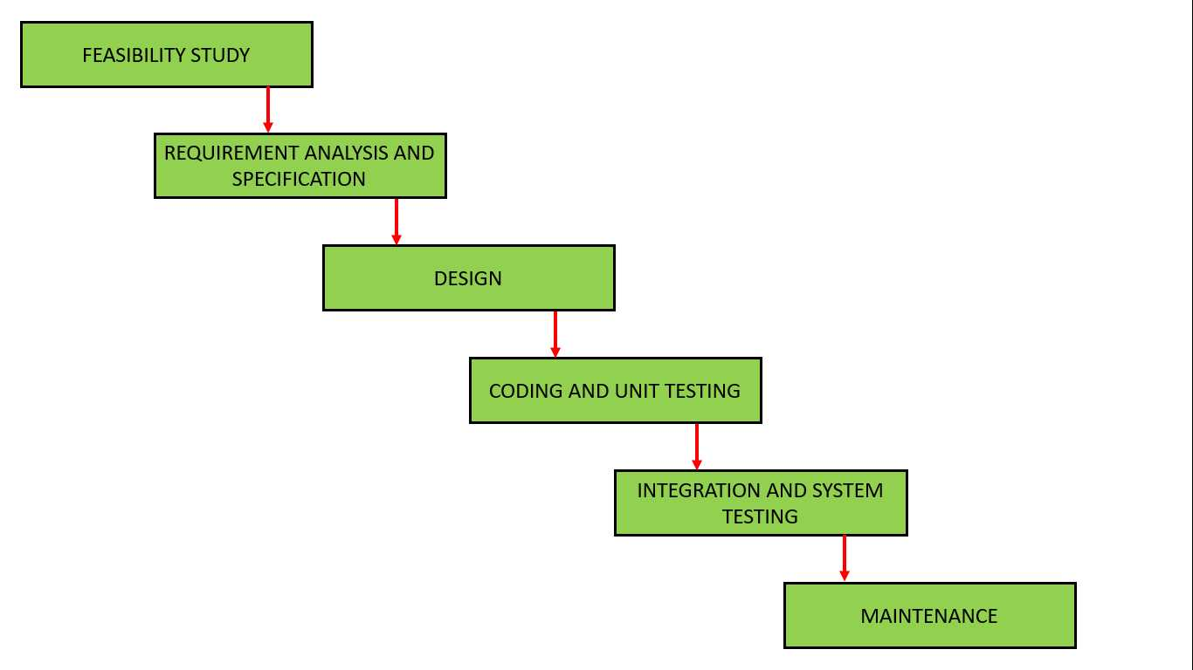
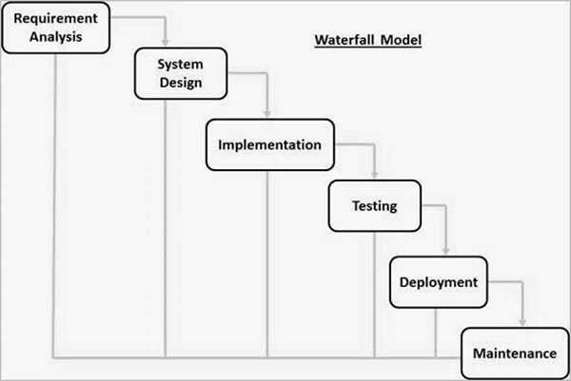
TYPES OF WATERFALL MODEL
1. Classical Waterfall Model
2. Iterative Waterfall Model

Slide 5
Advantages of the Waterfall Model
1. Simple and Easy to Understand: The Classical Waterfall Model is really straightforward.
2. Individual Processing: In the Classical Waterfall paradigm, each phase is handled independently.
3. Properly Defined: Every step in the traditional waterfall paradigm has a precise definition.
4. Well-defined Milestones: The milestones in the traditional Waterfall approach are extremely well-defined and understood.
5. Properly Recorded: The procedures, activities, and outcomes are meticulously recorded.
6. Reinforces Good Habits: The define-before-design and design-before-code principles are promoted by the classical waterfall model.
7. Working: Smaller projects and projects with clearly defined requirements are a good fit for the classical waterfall model.

Slide 6
Disadvantages of the Waterfall Model
1. Inflexibility: Once the procedure has started, it is difficult to adapt.
2. Late Testing: Costlier fixes are required when errors are discovered later in the development process.
3. Rigid Structure: For projects whose needs may change, the model is too fixed.
4. Lack of Customer Involvement: During the development stages, little input from customers is taken into account.
5. No Working Software Until Late: The program will not be available until the very end.

Slide 7
Conclusion
In conclusion, the Waterfall Model is a fundamental method in software engineering that provides an easy-to-manage and well documented development process. However, it is less appropriate for complicated projects whose needs may change over time due to its linear character and lack of flexibility. Although the Waterfall Model has drawbacks, it offers important insights into how software development techniques have changed over time.

Slide 8
References
“Applying UML and Patterns”- Craig Larman Motilal
https://www.tutorialspoint.com/sdlc/sdlc_waterfall_model.htm

